Slide 1
托福写作
许海燕

Slide 2
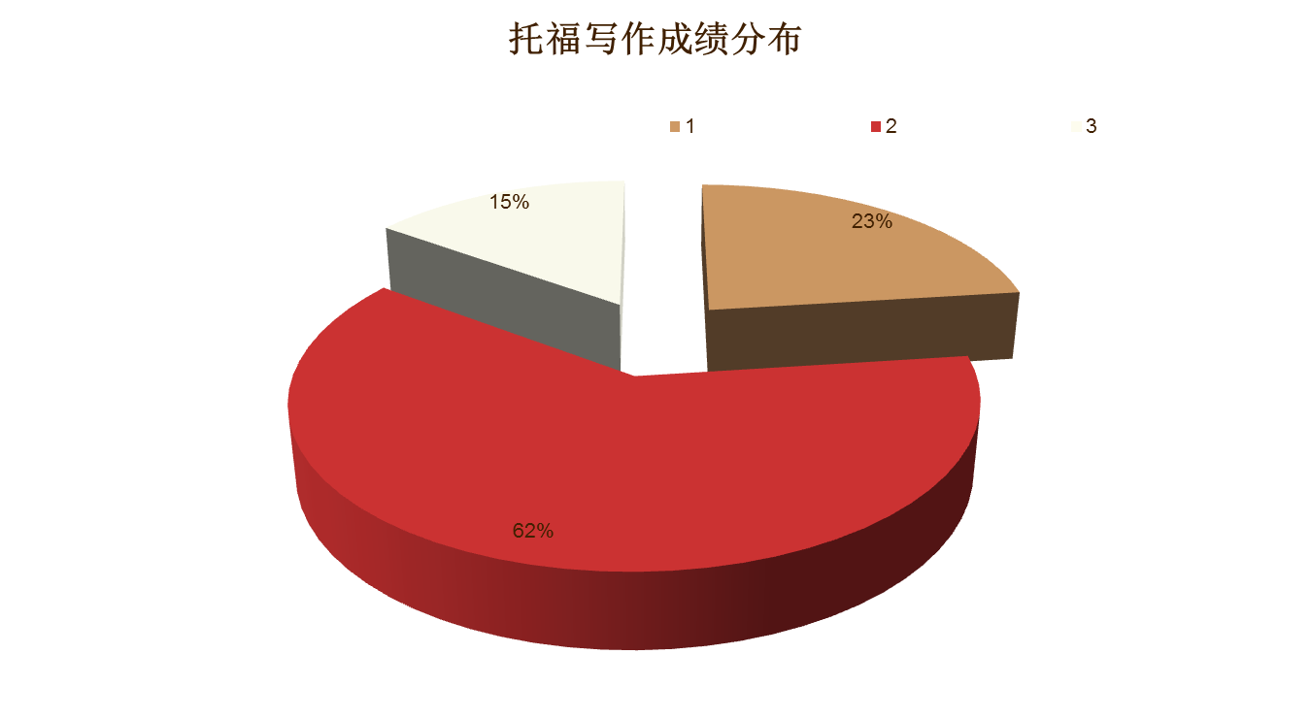

Slide 3
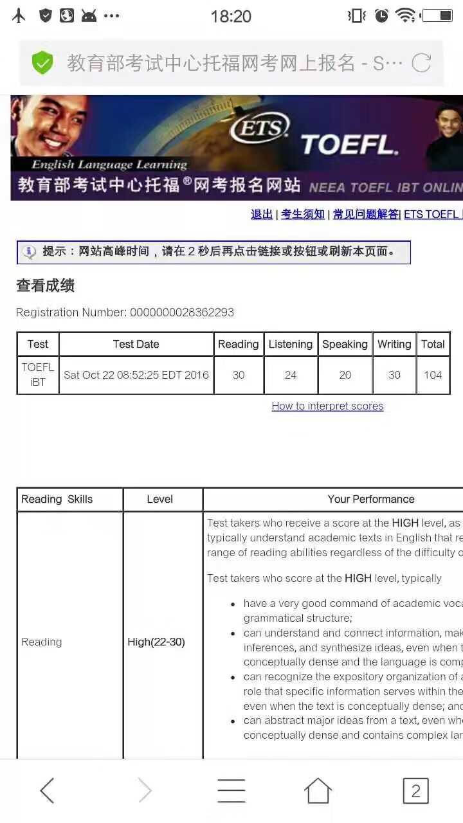


Slide 4
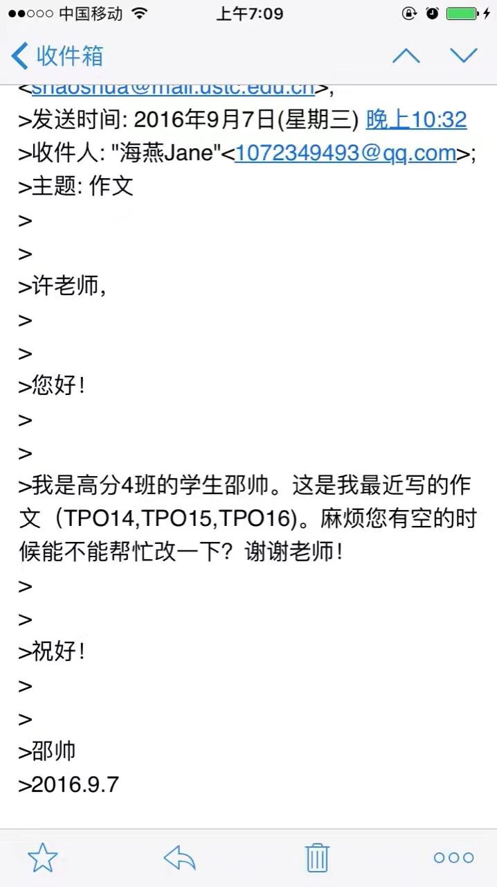
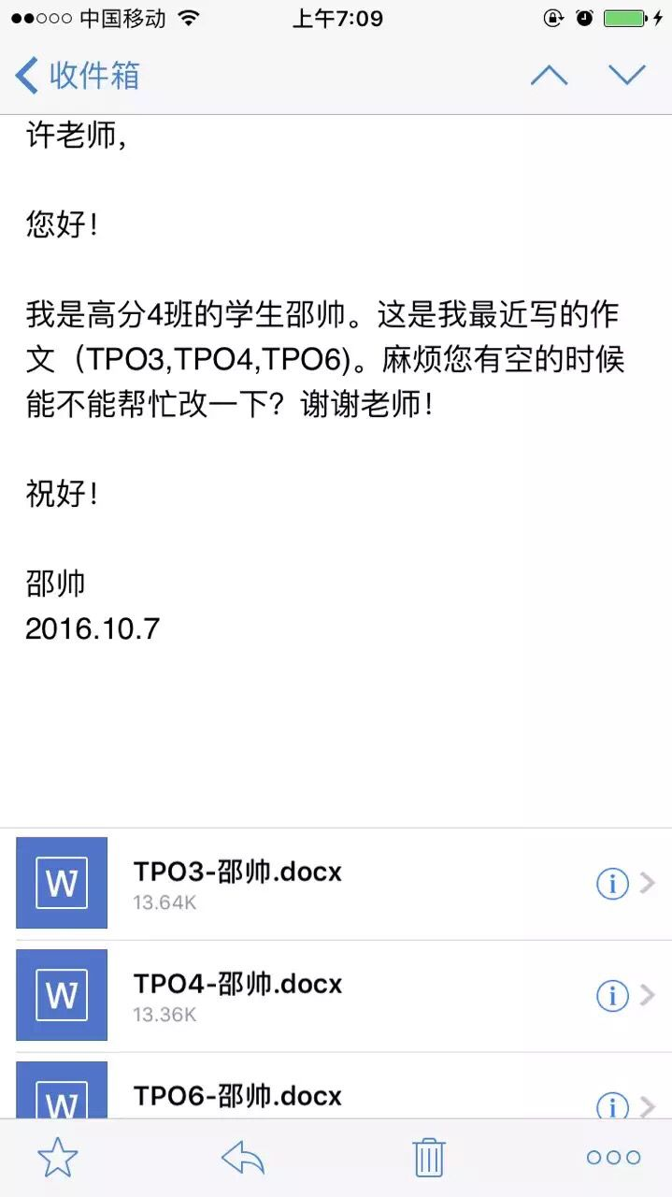

Slide 5
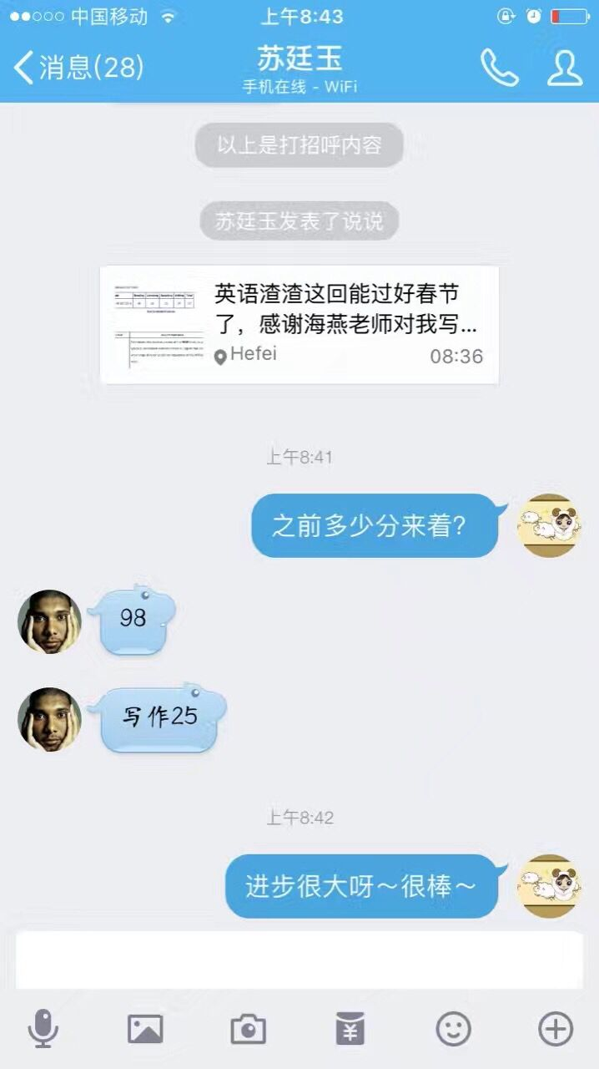
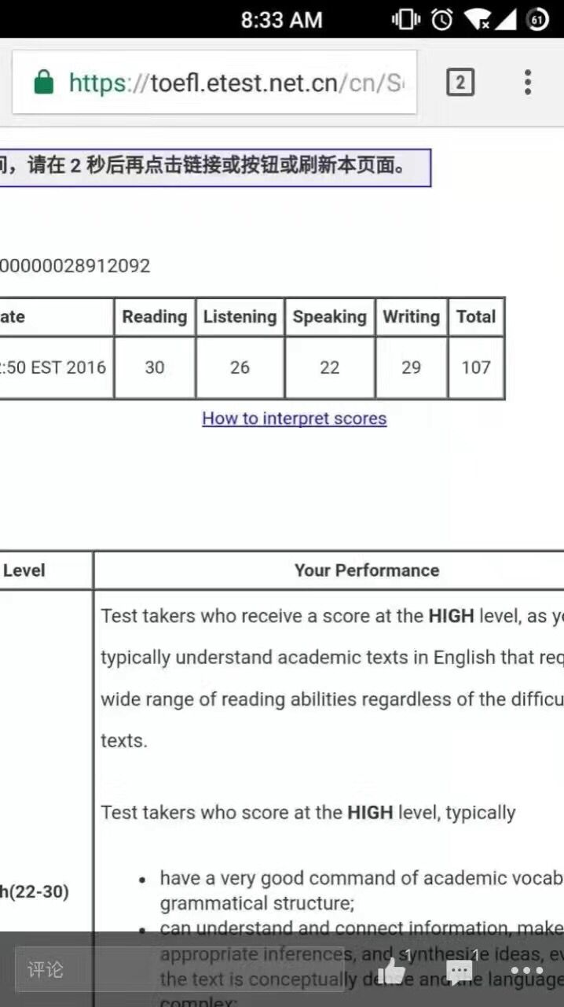

Slide 6




Slide 7
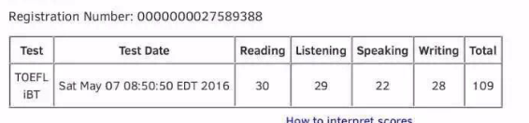
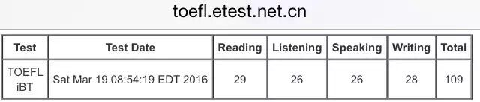
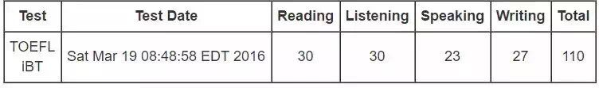

Slide 8
托福独立写作评分标准
1. effectively addresses the writing task
2. is well organized and well developed
3.uses clearly appropriate details to support a thesis
4.displays consistent facility in the use of language
5.demonstrates syntactic variety and appropriate word choice, though it may have occasional errors.
*⼈人批&机器批?

Slide 9
1.有效地针对话题完成任务（不跑题）
例1：Agree or disagree:spendingg too much time on watching sports on TV and following your favorite team would have a bad effect on your life.
例2：Nowadays, it is much easier for a person to achieve success without family's help than in the past.

Slide 10
2）+3）能充分展开，结构清晰；使用适当的解释和例证
主题句：环境保护有利于经济发展
说理论证：环境好1)招商引资;2)推动旅游业
细节例子：新加坡（或你所居住的城市）

Slide 11
1)主题句：英语是国际性语言
2）解释：因为英语大国很发达，主导世界，其他国家为了学习其先进文化和科技，鼓励学英语，客观上使得英语成为国际通用语言。
3）例证：去日本旅游，可以用英语沟通。

Slide 12
4）连贯性（形式上和内容上） *形式上：transitional words：
逻辑连接词（段落，句间，句内）
段落：first, moreover, however, in sum
句间：因果，对比，让步，目的，举例

Slide 13
内容上：指代、重复
My view is that young people should be encouraged to broaden their horizons.That is the best way for them to get a clear perspective of what they are hoping to do with their lives and why.Students with such a perspective are usually the most effective and motivated ones and taking a year off may be the best way to gain this.
Over the last half century the pace of change in the life of human beings has increased beyond our wildest expectations.This has been driven by technological and scientific breakthroughs that are changing the whole way we view the world on an almost daily basis.This means that change is not always a personal option, but an inescapable fact of life, and we need to constantly adapt to keep pace with it.

Slide 14
5. 句式丰富，措辞合适，允许小的错误
1）句式变化： 形式主语、存现句、各种从句、后置定语、 人为主语、物为主语、倒装、分词做状语、动词名词化、 插入句等（*美国留学是我的梦想；*备考托福的过程提升英语能力*旅游业最近几年发展不错。)
Studying in the US is my dream.
I dream of studying in the US.
My dream of studing in the US take roots in my heart.
The period when I was preparing for TOEFL saw a dramatic rise in my English.
Tourism has witnessed an unprecedented boom in recent years.
witness 见证 unprecedented adj. 空前的，史无前例的 boom n. 繁荣 booming tourism 蓬勃的旅游业

Slide 15
2）措辞合适：
1. 大学校的学生可以接触到好的老师和很多教学资源。
Students in a larger university can touch good professors and many teaching resources.
Students in a larger university have access to excellent professors and abundant teaching resources.
access 接近 have access to... 有接触……的机会，可以利用

Slide 16
2. 由于社会竞争激烈，如今父母非常重视孩子的教育。
Because social competition is serious, nowadays parents value children’s education very much.
Due to the fierce competition in society, nowadays parents attach great importance to children’s education.
attach 贴，附 attach importance to 重视

Slide 17
3. 我们应该利用在学校中的每一天，因为人生中的这一重要时期 有助于未来成功。
We should use every single day spent on campus, because this crucial period in life is good for future success.
We ought to make full use of every single day spent on campus, because/ as/ since/ for this crucial period in life definitely constitutes a stepping stone to future success.
充分利用: make full use of/ make the most of /take full advantage of a stepping stone 垫脚石
constitute a stepping stone to success 有助于成功，为成功奠 定基础

Slide 18
3)允许小的错误（最好不好出现）
词性的选择、词语的搭配和单词的拼写要正确
during the process of children's grown
Defective information may be offered from the internet.
However, others argue that school is the place where children can learn the way to be a good number of the society.

Slide 19
英美拼写问题以及缩写
（1）-re与-er
中心 戏院
（2）-our和-or
丰富多彩的 劳动
（3）-ise,-isation与-ize,-ization
意识到 组织，机构
（4）-ce与-se
执照 防守
（5）英式在美式拼写中被简化
节目 旅行者

Slide 20
中国学生最易犯的七类语法错误
第一类
1.Employee can get more benefits from telecommuting(远程上班) than employer.
第二类
2. Work at home using modern technology can greatly enhance our efficiency.
3Children who are raise in impoverished families can generally deal with problems more effectively in their adult years.
4. The problems that are created by environmental contamination is very hard to resolve.
5. Many students are like studying home economics.
6. Cultures around the world were becoming increasingly similar today.

Slide 21
第三类
6. Intelligent students should not be treated different by their teachers.
第四类
7. Countries should pay attention on the disadvantages globalization may create.
8. The internet has instead of teachers in many classrooms.
第五类
9. Some parents do not obey traffic rules himself.

Slide 22
第六类
10. Some people think the Internet only has positive impact, other people believe it also has negative influence on our lives.
第七类
11. There are many parents think that the main purpose of education should be to provide children with knowledge.

Slide 23
句子层面
破句
破句是把不完整的句子当作独立的句子来写时发生的错误。
Students should be encouraged to take part-time job. Because it will benefit students and their family, even the society as a whole.
International travel has given rise to large numbers of employment opportunities. For example, retail, hospitality and transportation.
Many sociologists point out that rural emigrants are putting pressure on population control. And also threatening to take already scarce city jobs.

Slide 24
3、错误的平行结构
1.一系列平行结构上的不正确使用
Many people choose air transportation because it is fast, offers convenience and it is not very expensive.
2逻辑上的不一致
The percentage of cancerous persons among smokers is significantly higher than non-smokers.

Slide 25
首段写作详解
第一步：引子
例题：Do you agree or disagree with the following statement? Parents should encourage their children to care for an animal.
要素：（）（）（）（）
现象法

Slide 26
现在，越来越多的孩子在家里养宠物。
Nowadays， more and more children are raising pets in their families.
不难看到孩子们和他们的家长在小区公园遛狗。
It is not rare to see children walking dogs with their parents in community parks.

Slide 27
题目：The most important investment that can be made to the education of children aged four to seven is giving them a computer.
背景法：
1. 关键词 investment of education giving children(4-7) a computer
2. 对象
3. 前因后果 attach importance to

Slide 28
背景法： Nowadays, due to fierce competition in society, parents attach greater importance to children’s education, thus providing their children with learning tools. //Some people claim that a computer is the preferred option, as children could have access to various study resources to enrich their knowledge with it.

Slide 29
Q：Living in big cities is a better choice.
Everyone has different dreams when it comes to where they wish to live. Some people think that living in a small town is desirable, while others choose city life. Personally, I would prefer to live in a large city. I feel this way for two reasons, which I will explore in the following essay.

Slide 30
练习
Only movies that can teach us something about real life are worth watching.
随着人们生活水平的提高，看电影似乎成为人们生活中不可或缺的一部分，因为电影不仅仅能娱乐观众，更能使之受到启发。
With remarkable progress of people's living standard, watching movies seems to be an indispensable part of people's life, as movies not only entertain the viewers but also enlighten them.

Slide 31
government should focus its budgets more on environmental protection than on economic development.
过去的几十年见证了全球经济的蓬勃发展。摩天大楼、便捷的通信、快速的交通让人们更舒适更方便地生活在这个星球上。但是，人们开始意识到如今的伟大成就似乎伴随着对环境的破坏。他们声称政府应该把更多的预算关注到环境保护上而不是经济发展上。对于我而言，。。。
the past several decades have witnessed that the world's economy is booming. modern skyscrapers, convenient communications, fast transportations make it easier and cozier for people to live in this planet. however, people are beginning to realize that the great achievements today seem to be at the price of destroying the nature. they claim that governments should focus its budgets more on environment than on economic development. as for me,...

Slide 32
第二步：转述题目
推荐句型：
Whether...has been a topic/ an issue of public interest and concern. (主语从句)
People have not reached a common idea whether...(同位语从句)
是否家长们应该允许孩子们养宠物是一个备受争议的话题。
家长们在是否让孩子养宠物这一问题上没有达成一致的意见。

Slide 33
第三步：观点
提出他人看法的句型：
Some people assert/argue/assume/believe that...(宾语从句)
Some people hold the idea/point of the view that...(同位语从句)
Others hold the opposite opinion that...(同位语从句)
阐明自己观点的句型：
Personally, I prefer the former(latter) opinion.
In my opinion/from my perspective, the first(second) point of view is more convincing.
Frankly, the former(latter) standpoint, I believe, is more acceptable.

Slide 34
第四步：铺垫
1）纯粹起引导作用
2）既起引导作用又有实际内容
As for me, I agree with the latter, especially when the following reasons are considered.(起引导作用，无实际内容)
Frankly, the latter viewpoint, I believe, is more acceptable, especially when its potential impact on children’s health and its possible influence to their studies are taken into consideration.(起引导作用，又有实际内容)
Based on the potential impact this has for doing harm to children’s health and studies, I prefer the latter opinion.

Slide 35
（补充：转述题目）
方法1：改变词性
题目：People who keep their room clean and tidy are more likely to be successful in the future.
同义改写：Those who are able to maintain the cleanness and tidiness of their rooms have more likelihood to succeed in the future.

Slide 36
方法2：使用同义词
题目：People who cannot accept criticism from others will not be successful when working in a group.
同义改写：People who are not able to accept being criticized by others are unlikely to achieve success when working in a team.

Slide 37
方法2：使用同义词
题目：People who cannot accept criticism from others will not be successful when working in a group.
同义改写：People who are not able to accept being criticized by others are unlikely to achieve success when working in a team.

Slide 38
换句式
方法1：主动转被动
题目：The government and corporation should share all their scientific discoveries with other countries in the world.
同义改写：All the scientific discoveries of the government and corporation should be shared with other countries in the world.

Slide 39
方法2：普通句转成强调形式、倒装形式或者复杂句等其他句式
题目：Teachers had greater influence on young children in the past than today.
改写1：It is greater influence that teachers have on young children in the past than today.(强调句)
改写2：Teachers’ influence on students in the past was greater than today.(主系表简单句)
改写3：In the past teachers had a crucial impact on students, but today their influence is fading.（并列句）
改写4：Despite the fact that teachers had a crucial impact on students, their influence is fading today.

Slide 40
方法3：定语从句转成非谓语动词
题目：Professional athletes who receive high salaries, such as football and basketball players, deserve what they get.
改写：Professional athletes being well paid, such as football and basketball players, deserve what they get.

Slide 41
方法4：状语从句转成非谓语动词
题目：If you cannot say anything nice about someone, you should say nothing.
同义改写：Having nothing nice to say about someone, you should say nothing.

Slide 42
其他方法
1.排比反问&提问式开头
题目：outdoor activities
Have you ever dived into a pool in the mountains? Have you ever jogged through the quiet forest? Have you ever enjoyed the sunshine on the afternoon beach? If you do not have such exciting experiences in your leisure time, you may sure lose something valuable that your life can offer. That is why I prefer to be outside than to be inside for my leisure activities.

Slide 43
题目换成：Buying a car or go traveling?
Have you ever been to the West Lake in Hangzhou City? Have you ever walked along the Long Corridor in the Summer Palace? Have you ever seen the red fallen leaves on the Fragrance Hill?If you have never had such experiences, you would never know how wonderful it is to go traveling.
注意：
1）3个事物
2）最好有层次感，可将三个理由罗列成三个事例，显得巧妙精致

Slide 44
Have you ever kept yourself waiting for a bus for an hour in the rain? Have you ever met some urgency so that you had to go to hospital but found no taxi around? Or have you ever regretfully told your country-living parents that it took too much time to go and see them b ut you wished you could? If you have not had such experiences, you would never know how important a car is.

Slide 45
People who do not have to work because they have enough money are barely happy.
How do we think of the relation between work and happiness? Do you agree that if you have enough money, you do not need to work? Is it true in your mind that money is the ultimate source for endless happiness? How do we define happiness? Have you ever experienced the days when you don’t have much money in the pocket but you still feel happy? Personally speaking, money is not so an important contributor to human’s happiness as work, and I would seek answers to all these questions in the following passage.

Slide 46
Have you ever seen/been annoyed (disturbed) by… ?
Is this the best/only/prime option (a wise decision/investment)?
Should sb. Be blamed for sth.?
Should sb. Shoulder/bear the responsibility of sth.?
How can we keep a balance between…?

Slide 47
提问式开头
例如：Competition between friends always has a negative effect on their friendship.
A friend in need is a friend indeed. Then, how about a friend in competition? It has been hotly debated on the issue that whether competition between friends could damage their friendship. Some people hold that competing with friends always has a negative effect on their friendship. On the other hand, other people think that is an unnecessary worry. From my perspective, I think competition between friends does not always have a negative effect on friendship as long as it is a healthy competition.

Slide 48
Do you agree or disagree with the following statement? There is never a reason for people to be rude (impolite) to another person. Use specific reasons to support your answer.
"Frankly, I think you’re boring.” Why do we seldom hear people speak so honestly? Unless you want to end a relationship, you don't tell another person what you think of her or him like this. Failing to be impressed by a friend's collection of stamps, yawning when a golfer tells you about that great shut he made on the 14th hole, or falling asleep when friends show pictures from their last trip to Sault Ste. are all things that educated people try not to do. This is what manners are about: acting in a civilized way to avoid misunderstanding, friction, and conflict. Therefore, it is always a good idea to be kind and polite.

Slide 49
设问练习
Do you agree or disagree with the following statement: students who keep their rooms neat and organized will be more likely to succeed than students who do not.

Slide 50
最近一个有意思的问题在学生群体中引起了关注，即整理房间和获得成功之间到底有没有关联？对于这个问题，仁者见仁，智者见智。有些学生认为整理房间和成功之间压根儿没一点关系。依我看，有整理房间习惯的学生的确要比没有这种习惯的学生更倾向于获得成功。我的观点基于以下理由。
Recently an interesting question has aroused attention among students: is there any correlation between cleaning the room and being successful?Answers vary from one person to another. Someone claims that students keeping room neat and organized is more likely to be successful while others do not think that cleaning up the room has anything to do with success.The way I see it, students who have the habit of keeping rooms clean and tidy is more inclined to succeed than those who never do it. my viewpoint is based on the following reasons.

Slide 51
2) 个例深入式
On a cold winter night, I woke and found my son lying aside me in fever with a 41.8 degree high. I carried my son in my arms and rushed outside to find a taxi but in vain. Along the street I caught sight of the car of my next-door neighbor's. With full gratefulness I begged my neighbor to take my son to the hospital. My son was saved in time because of the car.
If you do not have such experience, you would never know how important a car is to your life.
注意：1）控制字数 ; 2）文章总体长度守恒

Slide 52
It is important for families to regularly eat their meals together.
Last evening, I had dinner with my parents, and last family get-together was three months ago. Although my parents and I live in the same city, we do not often have meal together because I am so busy with my personal business and my work. I know that my story is not rare, and it is actually one of thousands of cases. From my perspective, having meal with families regularly is quite significant for strengthening family bonds and compensating for our lack of communication.

Slide 53
Strict parents will make kids more successful in the future.
The other day, I met Jenny, my schoolmate, who told me that she had no weekends at since her parents required her to play the piano and ten take TOEFL lessons. She said that she had an extremely tight schedule, and her parents had high expectation on her and zero tolerance for any sigh of laziness. Jenny’s story is not unusual, but it is a rather typical case instead. However, I believe that being strict is not a right way that can lead to children’s success.

Slide 54
个例深入常见表达
Last Sunday/ The other day/…
Once in a hospital/school/street/newspaper, I saw/read of/ learnt…
Once upon a time, there lived a man who… This story may be unbelievable, but it still has a realistic significance now.

Slide 55
三、定义式
Outdoor activities& Indoor activities
By outdoor activities is meant physical activities, such as mountain climbing, swimming, skating and camping, while indoor activities are often referred to as mainly mental activities, such as watching TV, playing chess, reading novels.

Slide 56
It is more important for a teacher to help students gain self-confidence than to teach them specific knowledge.
A teacher is someone who input knowledge into students’ minds, arouse students’ incentive thinking and stimulate students to succeed. A majority of people say that teaching students knowledge is teachers’ most important task. However, I tend to agree that teachers should put more emphasis on helping students be self-confident rather than teaching something written in the textbook.

Slide 57
Some people prefer to study alone. Others prefer to study with a group of students. Which do you prefer?
Study is an application of the mental faculties to acquisition of knowledge. Studying habit, such as studying along or studying with a group of students, is a personal preference. From my perspective, studying in a group is a better way since it can give us a stimulus, verified sources of knowledge, and interaction with other people.

Slide 58
四、引语式
注意要贴切：example “to be or not to be, that is a question”用于投资书还是电脑
“knowledge is power.”university is where people are empowered with knowledge, which is conducted mainly in classrooms and libraries. If we insist on that the main aim of universities is to impart knowledge to students, then library should deserve higher priority than gymnasium as far as investment is concerned.

Slide 59
名人名言、谚语、歌词改写或直接引用
例如： Most of business people are only motivated by the desire of money.
As a saying goes “Never raise early without proper profit”, business people are often characterized as greedy, snobbish and mean in literature works. In real life, business people often leave to others an unfavorable impression of money-driven slaves and thus some people think the desire of earning money occupies merchants’ whole minds, and all their actions are motivated only by golden and silvery stuff. However, the opponent insists that the desire of money is only one of the driving power that urges business people to “raise early”. To my thinking of way, it is not convincing that all the businessman work hard only for the sake of money.

Slide 60
2)注意积累不要杜撰
“the foreign moon is rounder than the domestic one”
“the grass is greener on the other side of the fence”
“ants in the pot”

Slide 61
追溯到我的学生时代，当时老师经常给我们布置繁重的家庭作业。事实上，直到今天，布置家庭作业的传统依然存在。正如孔子曾经说过的：学而时习之，不亦悦乎？做家庭作业，正是将这句话付诸行动。然而，尽管如此，过多的家庭作业所导致压力可能会产生负面影响。在我看来，每天布置家庭作业是有必要的，然而作业量不宜过多。

Slide 62
Tracing back to my school years, teachers used to give us a heavy load of homework. In fact, the tradition of doing assignment after school is still adopted in all schools today. Just as Confucius once said, "To learn with constant perseverance and practice what you have learned is a pleasure." Doing homework is a perfect conduction of this notion. However, pressure caused by too much homework might bring about negative consequences. In my view, assigning homework every day is necessary, but its amount should not be excessive.

Slide 63
评价，打分
Do you agree or disagree with the following statement?
Students are more influenced by their teachers than by their friends.
Use specific reasons and examples to support your answer.

Slide 64
评价，打分
习作，主体段1
An equal relationship can strengthen the impact. Have you ever feel afraid of your teachers? Have you ever feel upset about your teachers' words? Have you feel reluctant to speak to your teacher because of his authority? If you do, you must understand why there are more oppportunities to communicate with your friends, which means more impression. Everyone needs to be reassured when he become frustrated or upset. Your best friends must be the one to comfort you in general. Their comfort words can better your emotions and deeply influence you since your mind is opened.

Slide 65
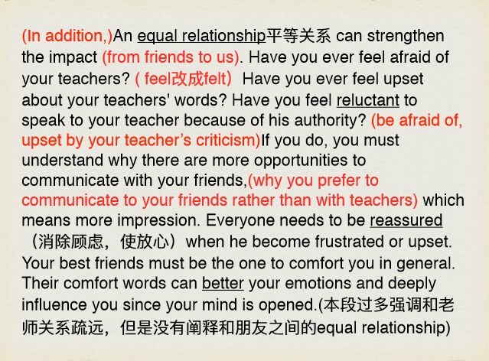

Slide 66
In the first place, friends afford students encouragement in adversity, thereby motivating them to overcome difficulty. Having shared a lot of memory, thought and interest with friends , I typically value words from them. If they expect me to accomplish something, I will try me best to prevent letting them down. Take me for instance, I enjoy coding and join an interest group where I make acquaintance with many people who share same interest with me. During a task, I was in charge of debugging a program while I happened to be sick in those days which result in my low efficiency. Before my choice to give up was made, my teammates suggested me to take it easy since they know I am proficient in this. Being grateful to their trust, I kept working for a several hours and finally finished my work ahead of the deadline. Had not it been for their encouragement, I would have given up.

Slide 67
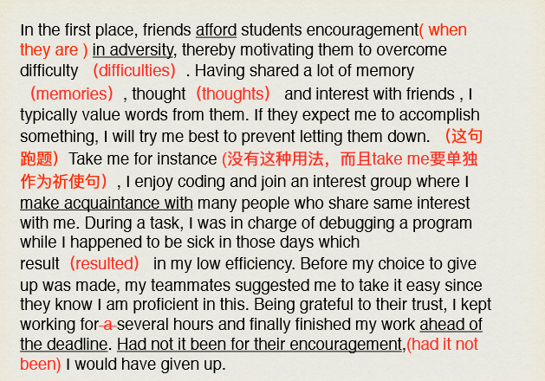

Slide 68
To begin with, the impact exerted by friends are more long-lasting compared with that put by the teachers. In most cases, we will have a friendship with a person for a long time, such as 5 or 10 years. However, our teachers are changing every semester, therefore their impacts are less strong. Take me as an example. My friend Mike, we were good friends since primary school. We went to school together, took the same class together and we even studied in the same group. Over the last ten years accompanied by Mike, I was greatly influenced by him. For instance, sometimes I would imitate his way of joking around or playing basketball and just because of him, I fell in love with popular music which I did not have a slight finger on. But as for my teachers, they did not have such a deep influence on me. I had three math teachers in the senior school, and each of them just imparted the knowledge and seemed equally ordinary. When the teacher was changed, the previous one did not influence me at all.

Slide 69
主体段
TS
Moreover, universities provide wonderful opportunities for networking which help young people find high-paying jobs following their graduation. The unemployment rate has been quite high for most of the past decade and it is very difficult for even well-educated people to find employment. Many experts argue that the people we meet in university play a large role in our long-term professional success. For example, my brother recently founded a successful online business which has provided him with a substantial income. He co-founded the business in a partnership with two like-minded students whom he met in a freshman computer science class. My brother often points out that the partnership which he formed with his students was even more valuable than the degree that he was awarded four years later. In contrast to my brother’s success, many of my friends who chose not to attend university have a limited set of contacts as their social circles have expanded very little since childhood.
Explanation
Example
Comparison

